Slide 1
NAAM MUDHALVAN
DATA SCIENCE PROJECT
By:
DEEPADHARSHINI S M(202131006) - A C TECH ANNA UNIVERSITY – APPAREL TECGNOLOGY

Slide 2
OUTLINE
Problem Statement
Proposed System/Solution
System Development Approach
Algorithm & Deployment
Result
Conclusion
Future Scope
References

Slide 3
PROBLEM STATEMENT
HOTEL BOOKING
Explore and analyse the data to discover important factors that govern the bookings.

Slide 4
PROPOSED SOLUTION
Analysing the given set of data using python program and extracting the required details as per the problem statement.
The python code has been uploaded separately.

Slide 5
SYSTEM APPROACH
for column in ['country', 'agent', 'company']:
df[column].fillna('None', inplace=True)
# Convert non-numeric columns to numeric
le = LabelEncoder()
for column in df.select_dtypes(include=['object']).columns:
df[column] = le.fit_transform(df[column])
# Define the target variable and features
X = df.drop('is_canceled', axis=1)
y = df['is_canceled']
# Split the dataset
X_train, X_test, y_train, y_test = train_test_split(X, y, test_size=0.2, random_state=42)
PYTHON PANDA
import pandas as pd
import numpy as np
from sklearn.ensemble import RandomForestClassifier
from sklearn.model_selection import train_test_split
from sklearn.metrics import accuracy_score
from sklearn.preprocessing import LabelEncoder
# Load the dataset
FILEPATH = 'hotel_bookings.xlsx'
df = pd.read_excel(FILEPATH)
# Preprocessing
# Fill missing values

Slide 6
# Train the model
model = RandomForestClassifier(random_state=42)
model.fit(X_train, y_train)
# Predict and evaluate
predictions = model.predict(X_test)
accuracy = accuracy_score(y_test, predictions)
# Feature importance
feature_importances = pd.DataFrame(model.feature_importances_, index = X_train.columns, columns=['importance']).sort_values('importance', ascending=False)
print('Model Accuracy:', accuracy)
print(feature_importances.head(10))

Slide 7
The dataset contains a mix of data types, including object (string), integer, and float.
Missing values are present in the children, country, agent, and company columns, with company having a significant number of missing values.
To address these issues, we need to convert object-type columns to strings and decide on a strategy for handling missing values, especially in the company column.

Slide 8
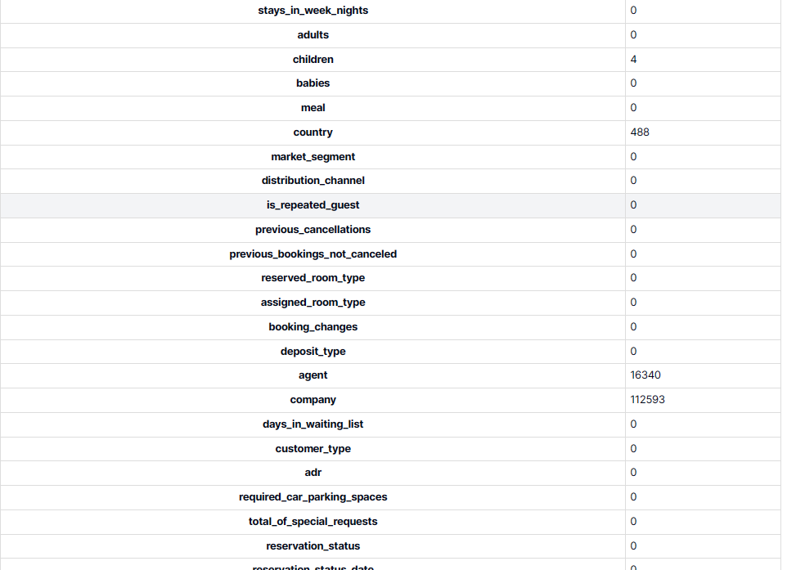
CONCLUSION

Slide 9
REFERENCES
Python panda data tutorial
IBM Skillset
Eduent
NM

Slide 10
THANK YOU

